Slide 1

Group 9 Project
Are Rent Caps an Effective Policy Tool?
Group Members:
Claire Cressman
Aissatou Diallo
Negin Kananizadeh
Vickylynn Mauldin
Christopher Oglesby

Slide 2
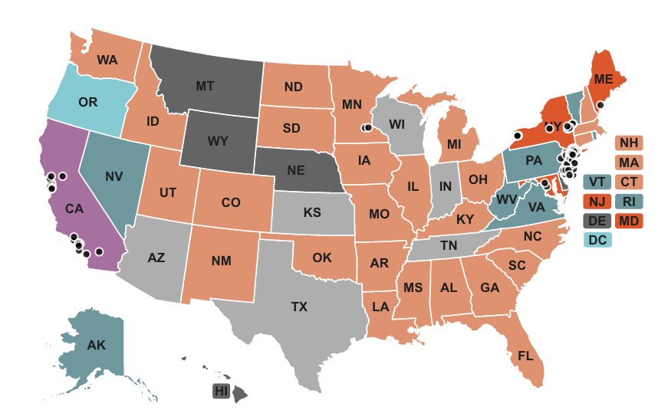
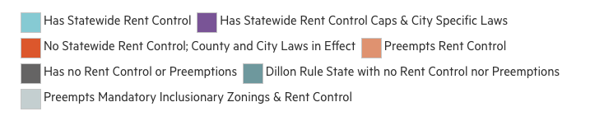
Motivation:
Acute economic volatility, catalyzed by the global COVID-19 pandemic in 2020, has caused significant financial turmoil in the US.
The goal of this analysis will be to isolate and evaluate these economic challenges in relation to the U.S. housing sector. Specifically, our analysis seeks to evaluate the influence and/or impact of rent control measures.
Graphics sourced from: https://www.nmhc.org/research-insight/analysis-and-guidance/rent-control-laws-by-state/

Slide 3
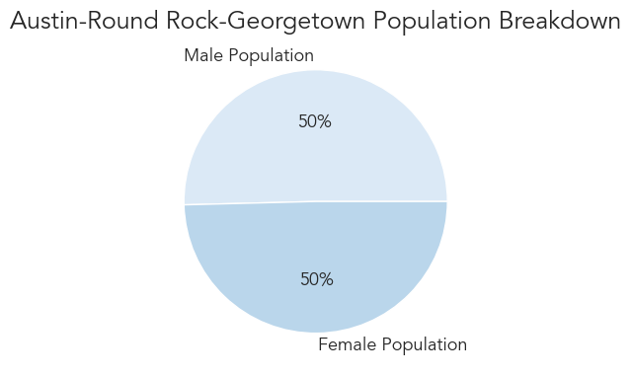
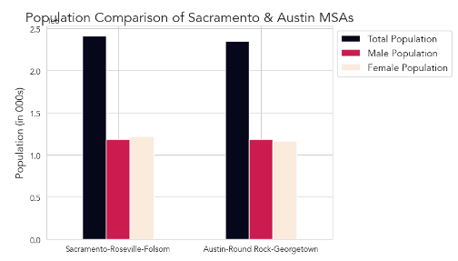
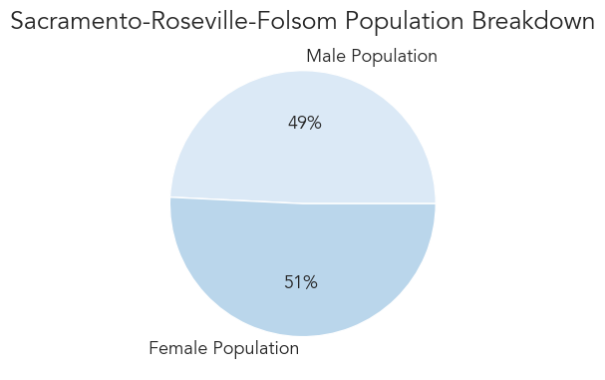
Austin and Sacramento MSAs:
Population Composition Comparisons

Slide 4
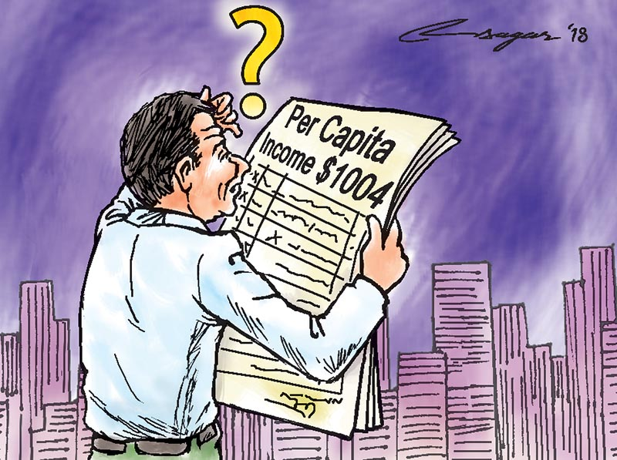
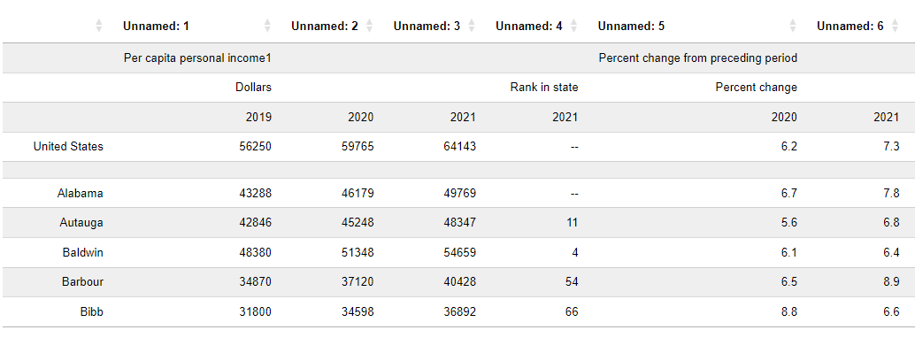
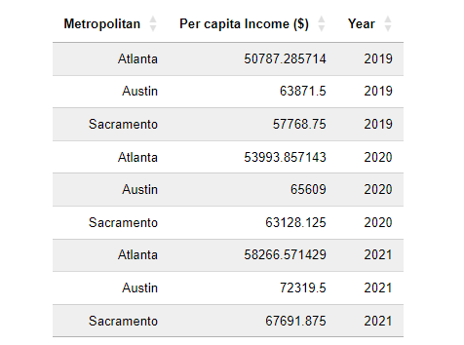
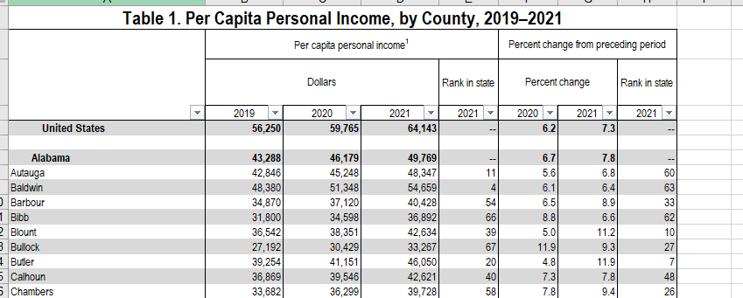
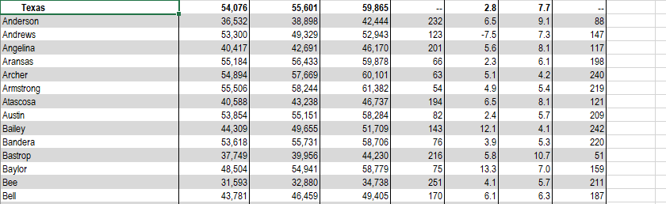
Per Capita Income
Data Source: Bureau of Economic Analysis
https://www.bea.gov/data/income-saving/personal-income-county-metro-and-other-areas

Slide 5

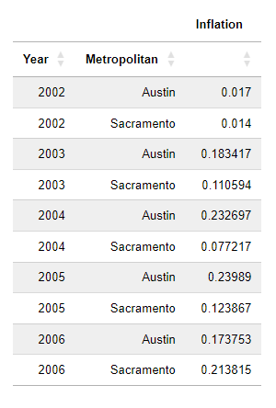
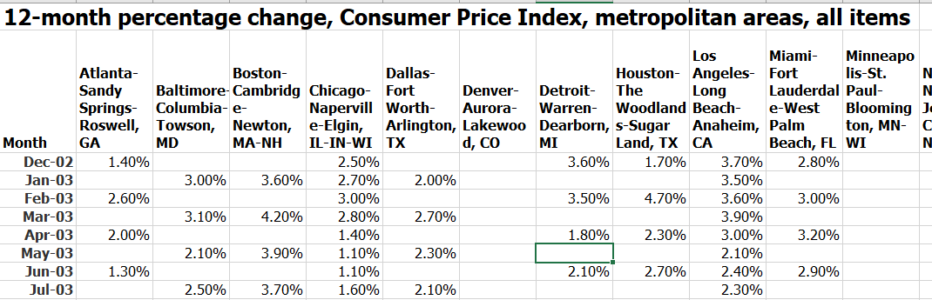
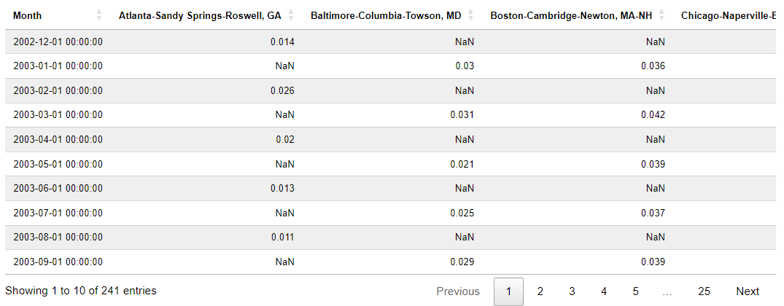
Consumer Price Index (Inflation)
Data Source: US Bureau of Labor Statistics
https://www.bls.gov/charts/consumer-price-index/consumer-price-index-by-metro-area.htm
Monthly CPI to yearly Inflation

Slide 6
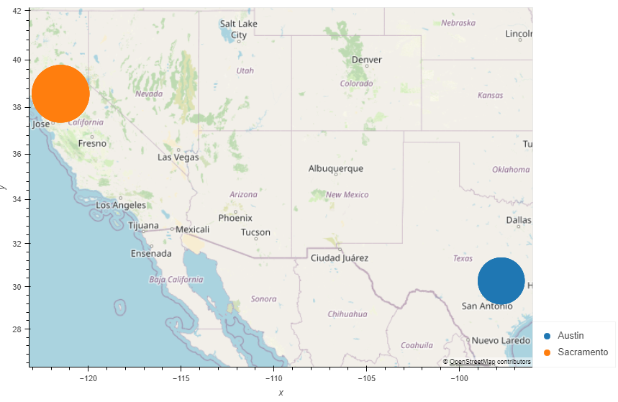
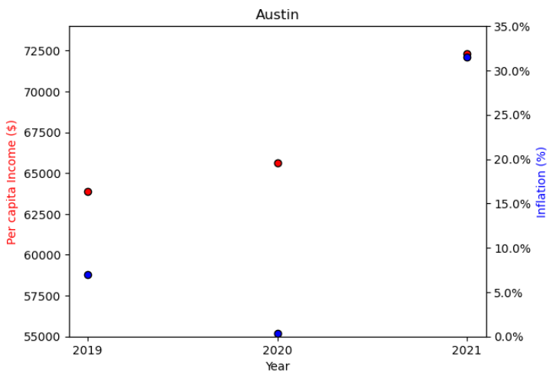
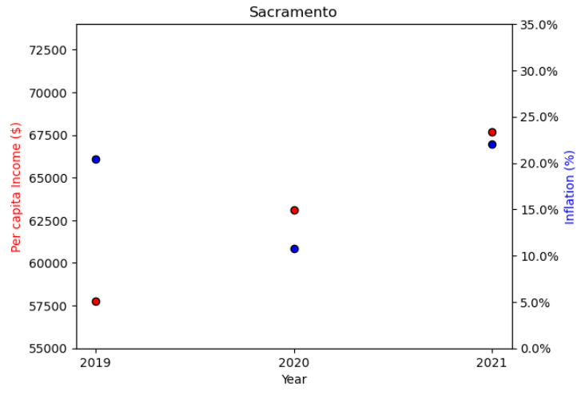
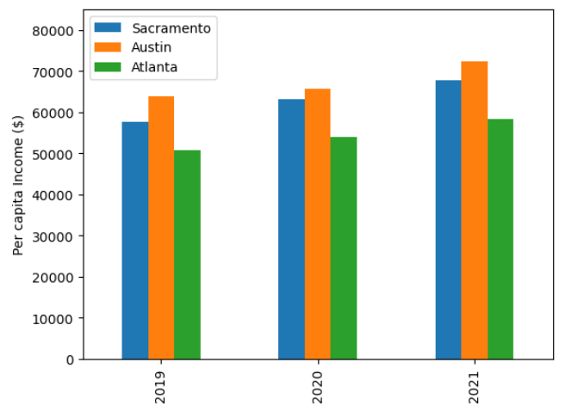
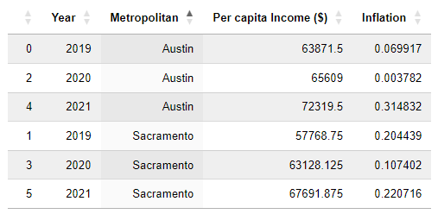
Per Capita Income vs Inflation vs Year
Covid dropped inflation, the same year salaries increased which led to a big increase in the inflation on 2021

Slide 7

Stock market and housing market 2015-2020
The stock market is a very large dataset with several parameters but for our analysis we have decide to use the date, month, symbols and closing price. Our analysis is going to evaluate how the 2020 pandemic had a financial impact on the stock market

Slide 8

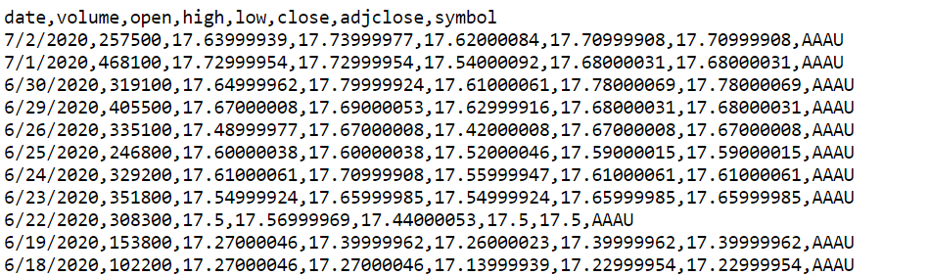
Stock market Raw data

Slide 9
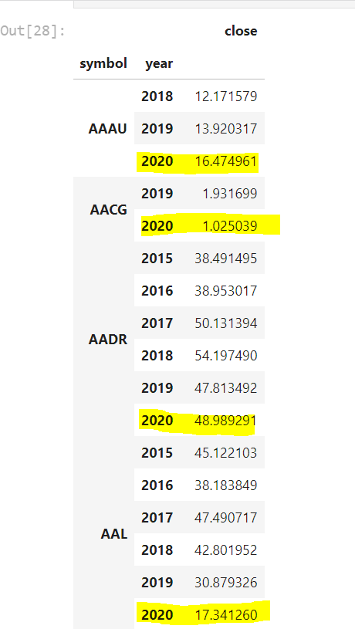
Average closing price per year and by symbols
We can see that there is a significant decrease of closing price during the pandemic.
AAAG (century Group USA) and AAL (American Airlines) decrease significantly

Slide 10
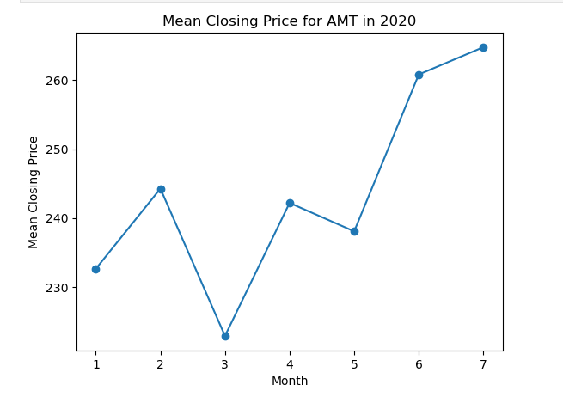
Stock Market Analysis for American Tower Corporation(AMT) in 2020
AMT is one of the largest global real estate investment in the housing market
We can see the financial impact of the pandemic on the AMT stock market in 2020.
In the midst of the pandemic the housing stock market declined significantly while during the summer we can see that the stock market is at its peak again because of the high demand.
.

Slide 11
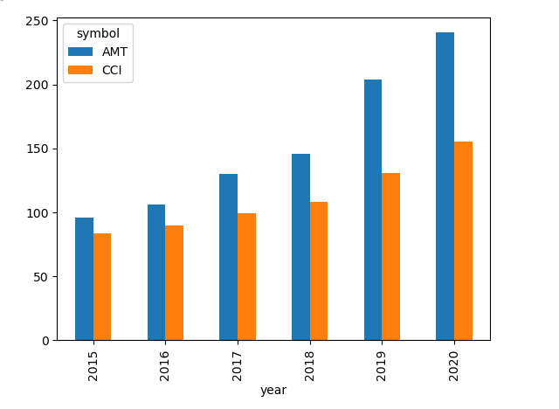
stock market comparison
We are comparing 2 large real estate investment corporations ( American Tower Corporation AMT and Crown Castle Corporation CCI) in the housing market and we can see an increase of their stocks prices from 2015 to 2020.
The widespread shift to remote work from home prompted many buyers to re-evaluate their housing options.
Also in 2020 due to the falling of mortgage interest rates, the cost to borrow money to buy a house was dropping and more people could afford to buy a house

Slide 12
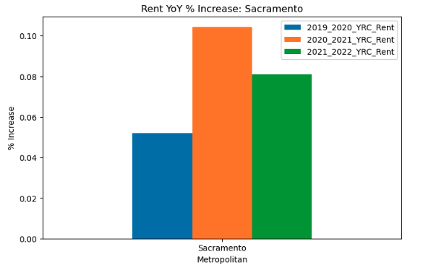
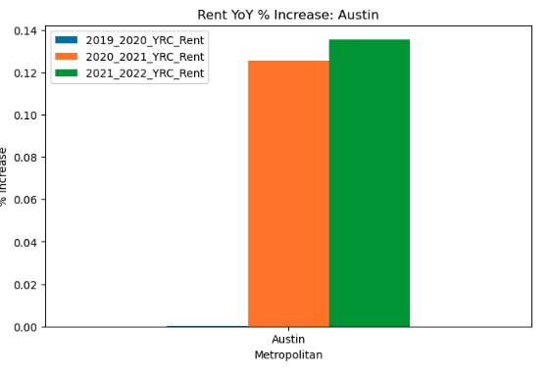
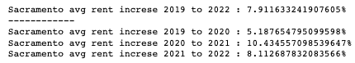
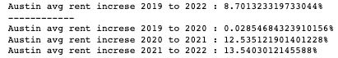
Year over Year Rent Increase Sacramento vs Austin
zillow data sources: https://www.zillow.com/research/data/
Notes:
https://www.zillow.com/research/data/

Slide 13
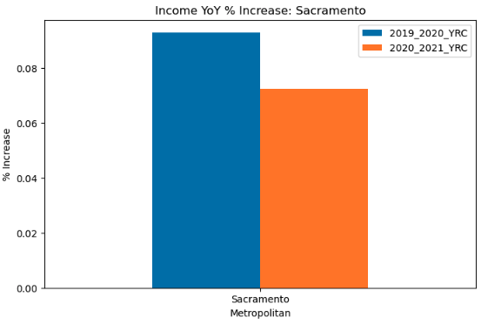
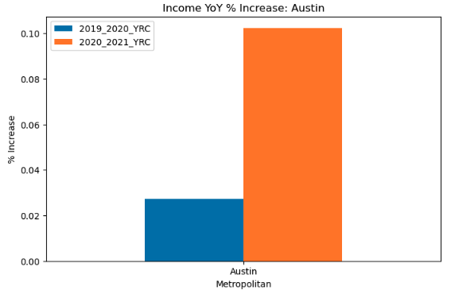

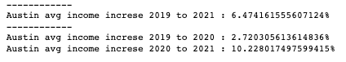
Year over Year Income Increase Sacramento vs Austin

Slide 14
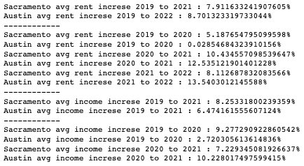
Analyst
Limit data set but can see Austin’s seeing greater rate of rent increases
Sacramento’s income increases to to match or is over their rent increase
Worth further review Austin over the past few years have become a new “tech hub”
Could be influencing the rental market
Could be driving income increase
Tesla Aug 2020 move announcement

Slide 15

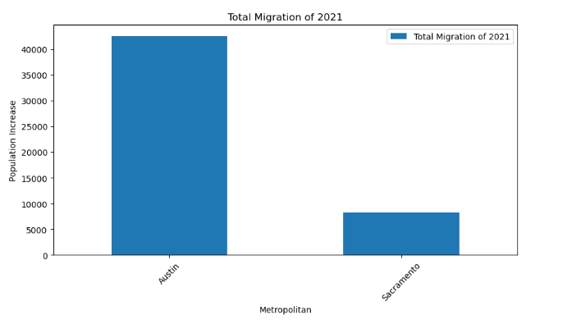
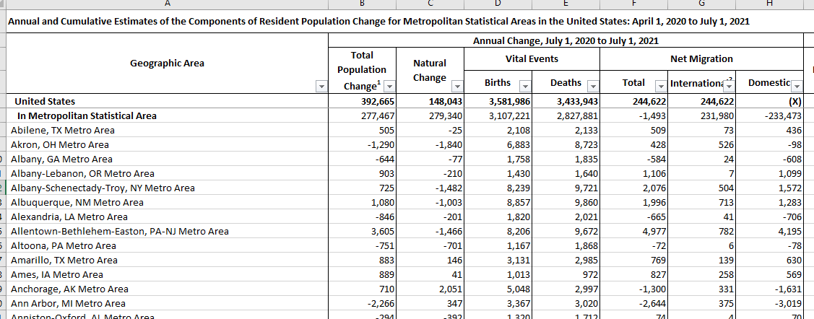
Is Rent Control Effective?
Migration Total For 2021

Slide 16

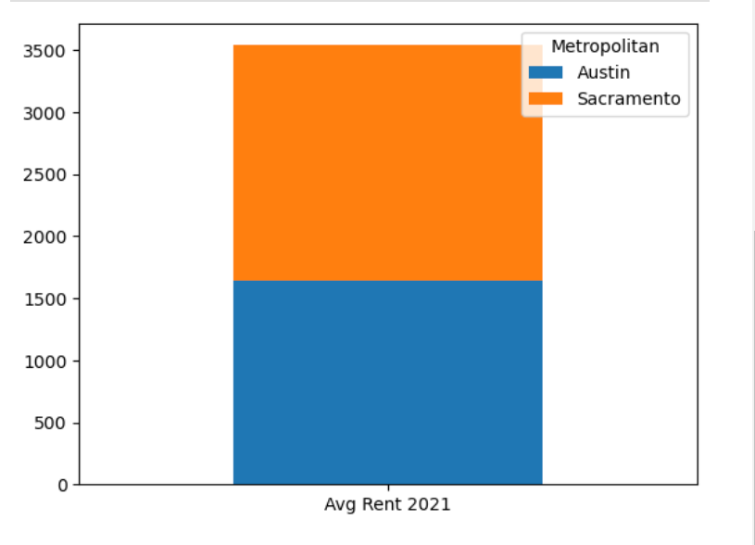
Rent Prices For Control Cities

Slide 17
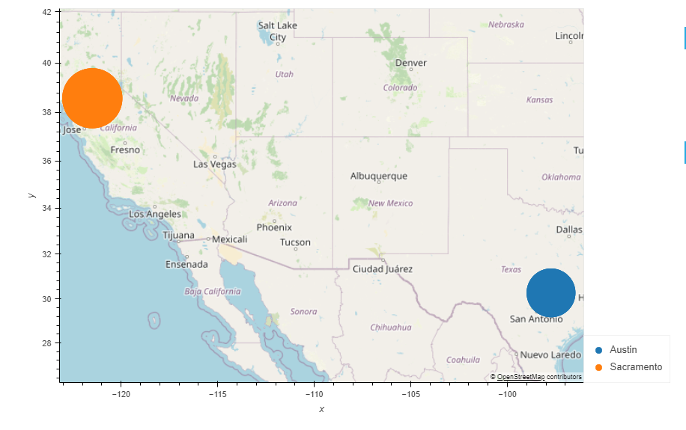
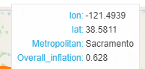
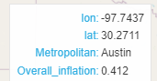
Conclusion
Covid dropped inflation, the same year salaries increased which led to a spike in the inflation in 2021.
Stock market price increased, people had more money, they started buying primary and investing houses. Housing got more expensive, which led to increase in rent.
Since 2020 rent control cities like Sacramento, had a lower rate of rent increase compared to non-rent controlled city, Austin.
Recent corporate relocation of tech companies to Austin has led to increased migration rates. These rate increases were higher than in Sacramento.
Many parameters affect the rent price recently. Covid, inflation, big tech companies relocating etc.

